Slide 1
Directions to use Visually Supported TASK-ANALYSIS for Turn and Talk/Think Pair Share type activities
Created by Project IMPACT at UNCC

Slide 2
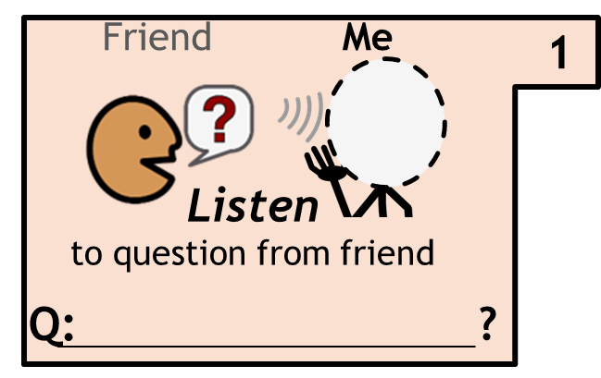
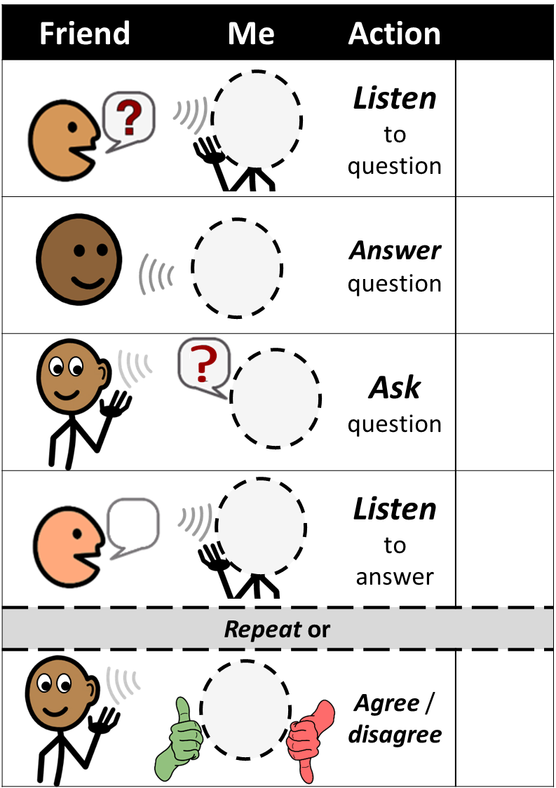
Turn and Talk-Task Analysis
Brett
How did the Neverbird feel
Read the question to your peer

Slide 3
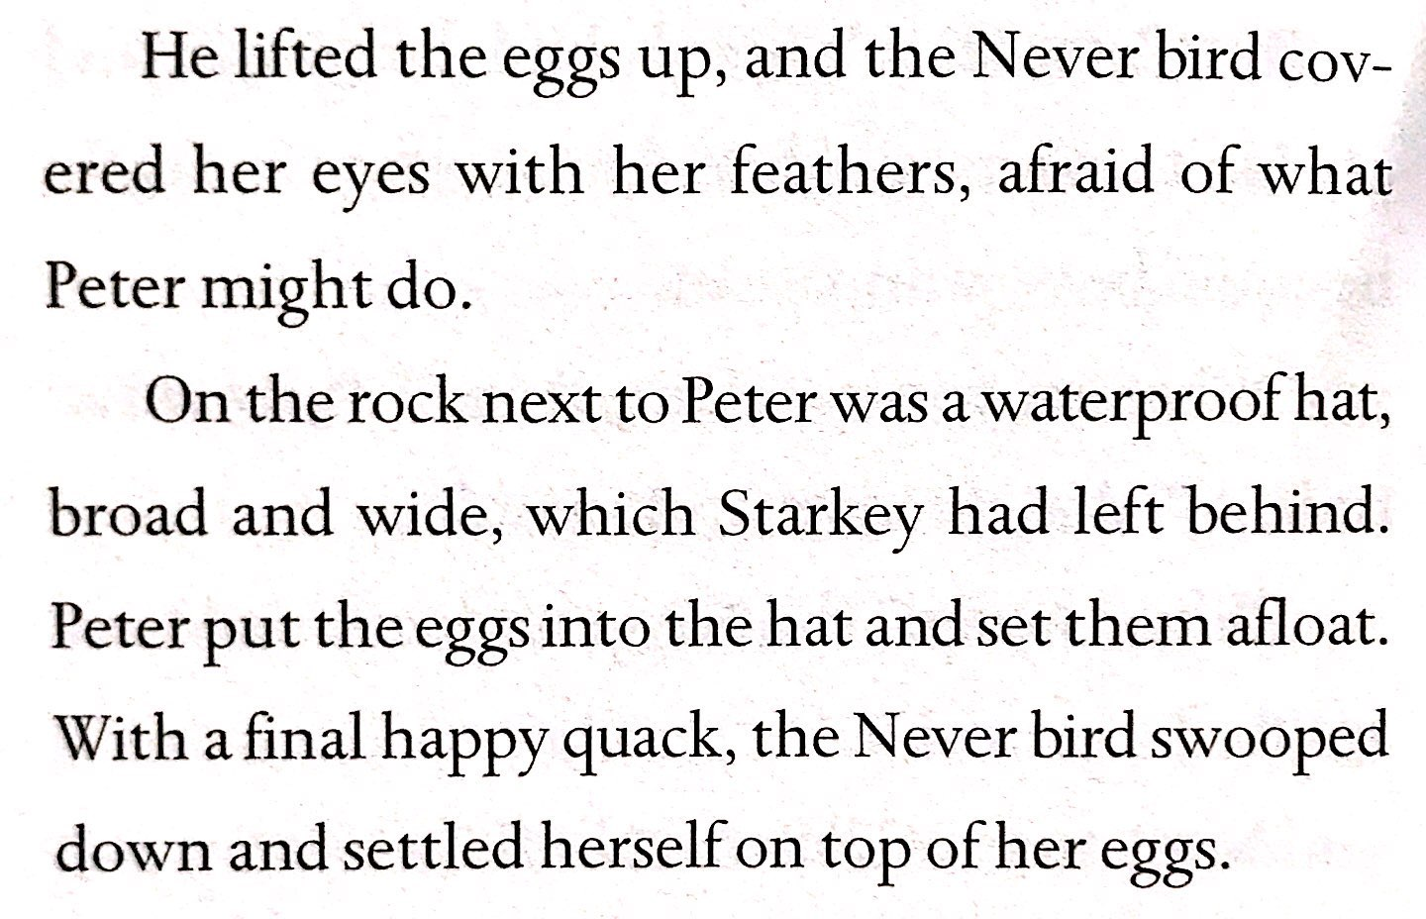
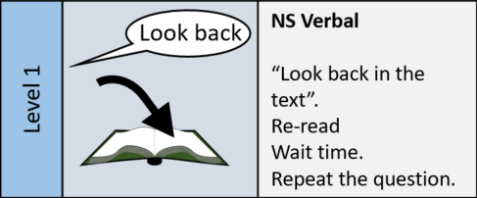
Error Correct
When Peter took eggs out of the nest, where did he put them?
Step 1
Peer does not know answer Peer gets answer wrong
Goal: Peer finds answer in story
Point to the paragraph the answer is in
Wait 2 seconds
Ask question again
From Peter Pan page _

Slide 4
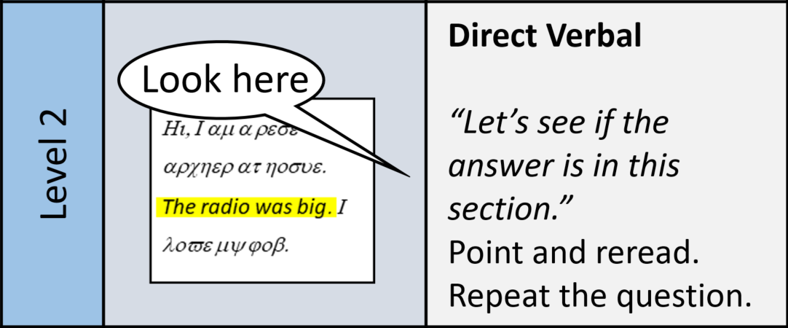
Error Correct
When Peter took eggs out of the nest, where did he put them?
Step 2
Peer can not find answer Peer gets answer wrong
Goal: Peer hears answer in story
Read one sentence with the answer
Wait 2 seconds
Ask question again

Slide 5
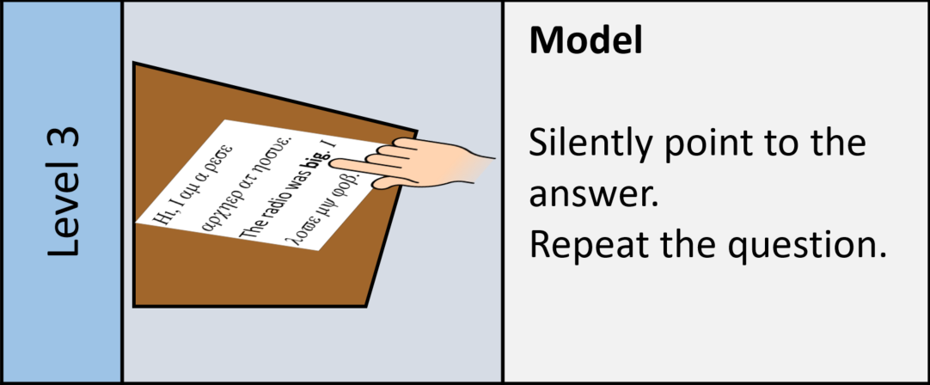
Error Correct
When Peter took eggs out of the nest, where did he put them?
Step 3
Peer can not find answer Peer gets answer wrong
Goal: Peer learns how to find the answer in their book
Point and touch answer in the book
Wait 2 seconds
Ask question again

Slide 6
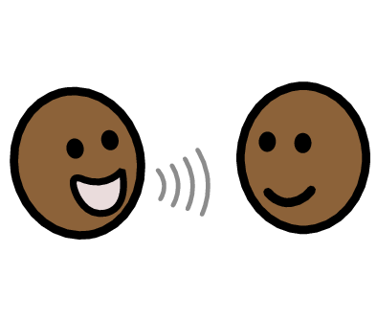
Turn and Talk-Task Analysis
Answer
friend’s question
Friend
Me
Brett
This reminds me of________________
When it said____, in my mind I saw ____.
This is similar to___________
This is different than_______
This made me feel________
Based on what I read, I think_________
It felt
2
Show peer the answer sentence starter
Let your peer try to answer
If the answer is wrong, help them find the answer in the book

Slide 7
Turn and Talk-Task Analysis
Ask
friend the question
Read from card .
Friend
Me
Brett
3
After they answer, it is their turn to ask the question
If they need help remembering the question, show them Card 1
If student cannot read the question, they can point to it

Slide 8
Turn and Talk-Task Analysis
4
Brett
Listen
to answer from friend
Friend
Me
After peer asks the question…
Answer the same way you would for any other peer
If the answer is in the book, show them where you found your answer

Slide 9
Turn and Talk-Task Analysis
Friend
Me
Agree / Disagree
with friend’s answer
Brett
Ask your peer, do you agree with me, yes or no
Give a fun reaction: “Good job” “I liked your answer” “You had a good answer” “Thank you for listening to my answer”
+/-

Slide 10
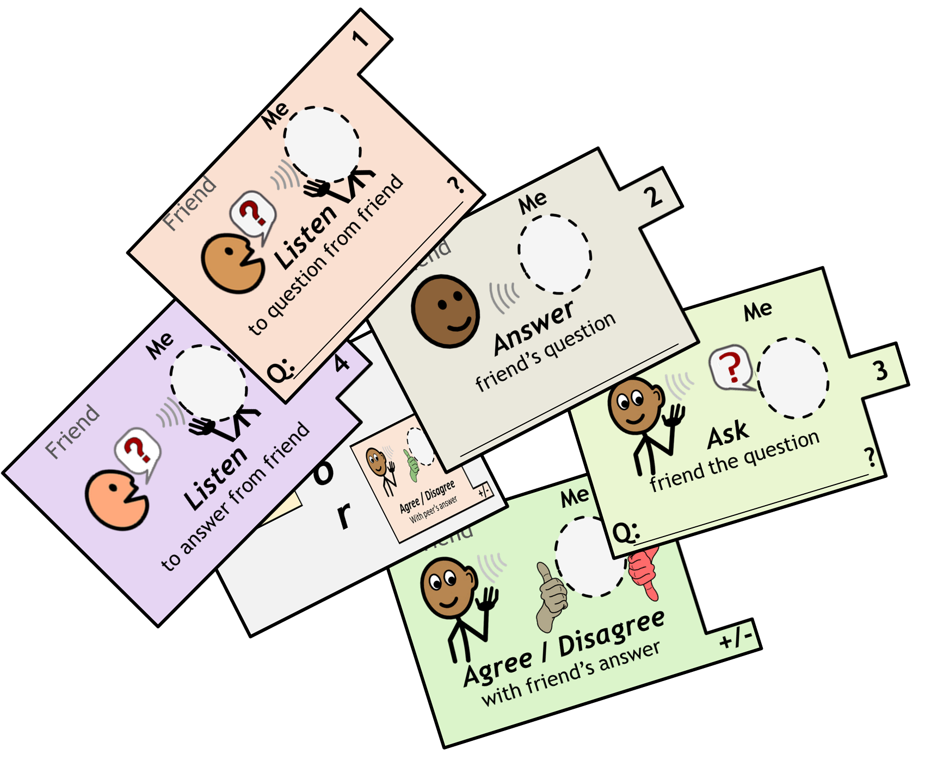

Slide 11
